Slide 1

Fern Hill Primary School
.
.
.
Inspiration Collaboration Empathy Excellence

Slide 2
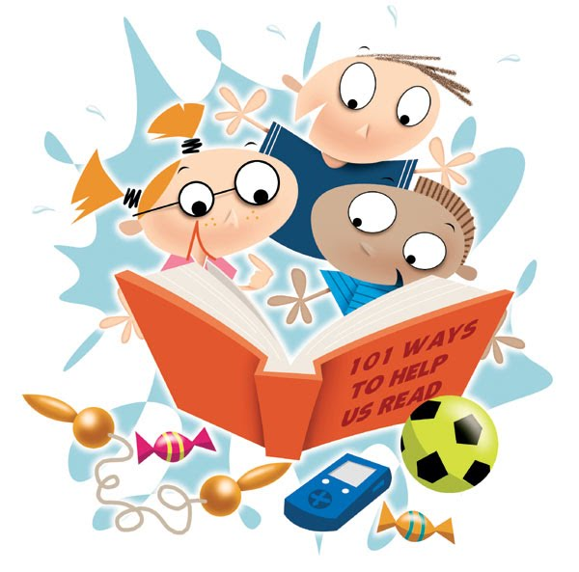

Phonics Screening Check

Slide 3
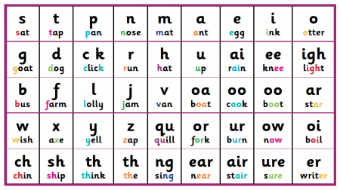
What is Phonics?
Children have 20-30 mins daily phonics lessons;
Children are taught to read by breaking down words into separate sounds or ‘phonemes’. They are then taught how to blend these sounds together to read the whole word;
There are around 45 different sounds.
Children are then encouraged to use these strategies to read and write across the curriculum.

Slide 4
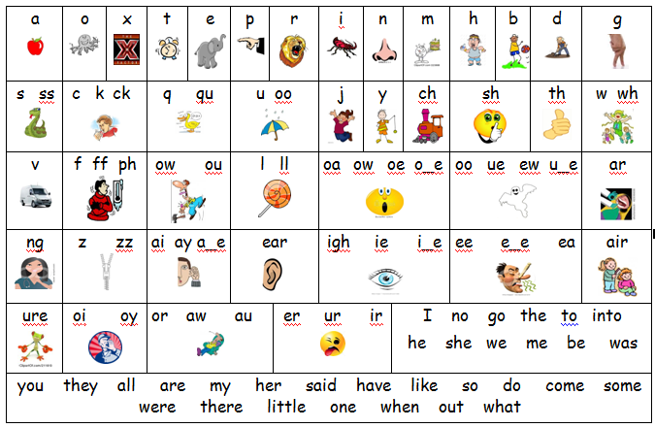
Example of the sounds children learn
https://www.youtube.com/watch?v=BqhXUW_v-1s&safe=active
This link will allow you to listen to the correct articulation of phonemes

Slide 5
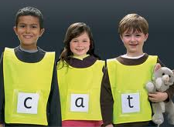
What is the screening check?
Every Year 1 child in the country will be taking this statutory phonics screening check in the same week.
The check is very similar to tasks the children already complete during phonics lessons.
The focus of the check is to check children’s blending and segmenting skills. The year 1 screening will provide evidence to help teachers plan for year 2.

Slide 6


Examples of words

Slide 7
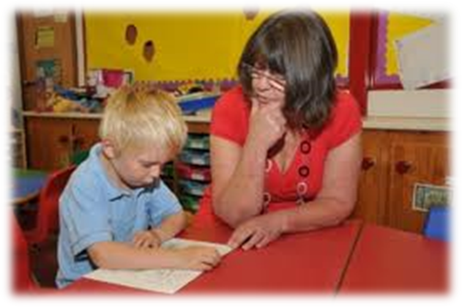
How will it be carried out?
Over the course of the week, the children will complete the check one to one with a teacher they are familiar with.

Slide 8

And the results……?
We will inform you of your child’s results in the summer term with your child’s report.
If your child’s score falls below the national standard they will re-take the Phonics Screening Check in year 2.

Slide 9

When will it happen?
The screening will take place throughout the week beginning 11th June 2018.
It has been designed so that children of all abilities will be able to take part.

Slide 10
How can you help?
Encourage your child to use their knowledge of sounds to work out the words when reading and writing.
Digraph- 2 letters making one sound cow the children should say this as c-ow and not c-o-w
Trigraphs- 3 letters making one sound night the children should say this as n-igh-t and not n-i-g-h-t which does not sound like night.
Split digraphs- 2 vowels with a consonant in between. Used to be known as the magic e! spine - i_e home – o_e cube – u_e

Slide 11

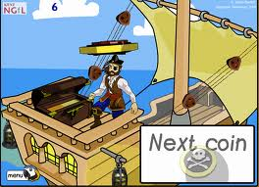

How can you help
Children can practise their phonics by playing games online.
They may like -
Buried Treasure
Poop-Deck Pirates
Picnic on Pluto

Slide 12
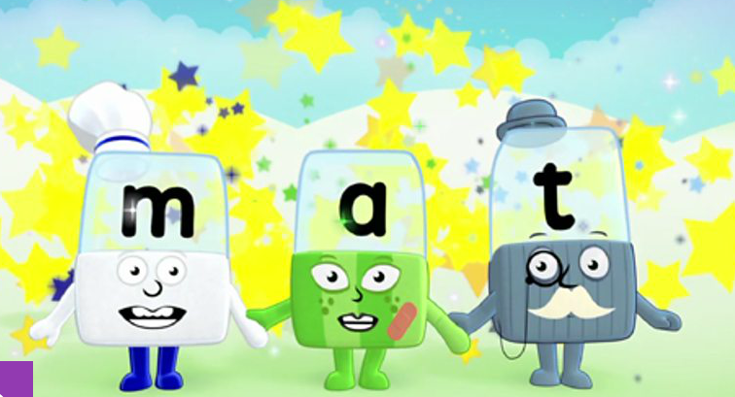

Useful Websites
BBC Alphablocks
http://www.bbc.co.uk/cbeebies/grownups/the-alphablocks-guide-to-phonics
Phonics Play
http://www.phonicsplay.co.uk/freeIndex.htm
Oxford Reading Owl
http://www.oxfordowl.co.uk/for-home/reading-owl/find-a-book/library-page
Mr Thorne does Phonics (Geraldine)
https://www.mrthornenetwork.com/

