Slide 1

Library Rules
?

Slide 2


Slide 3
Books can only be taken from the library when they have been scanned out by an adult.

Slide 4
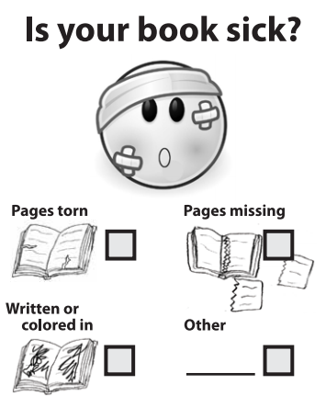


Slide 5
Look after the books - treat them with care and respect!

Slide 6
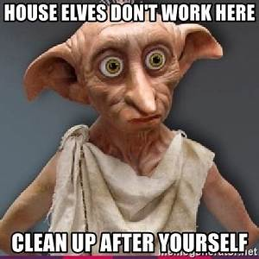


Slide 7
Keep the library area tidy - put books back in the correct place.

Slide 8


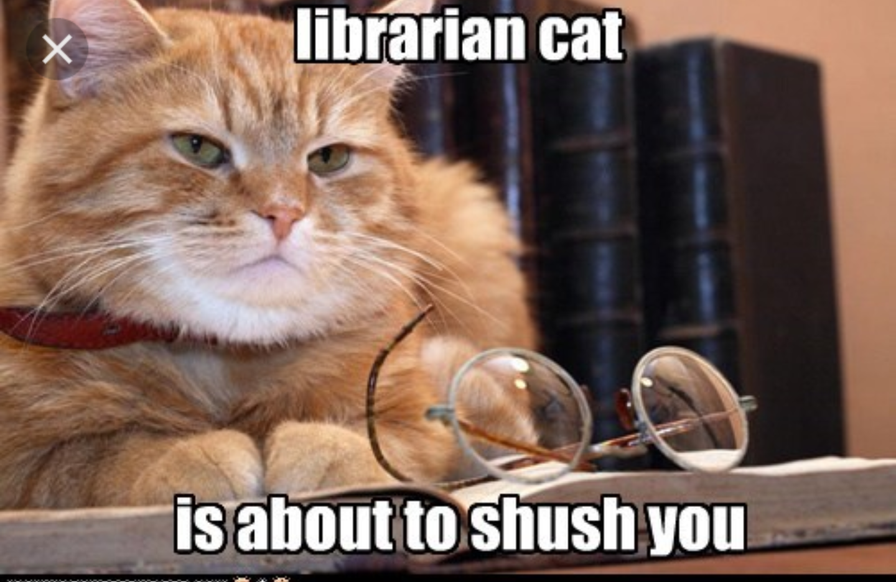

Slide 9
Be quiet and sensible in the library space as others are working.

Slide 10


Slide 11


Slide 12
Books need to be returned to Mrs Eakin when you have finished with them so others can enjoy them.

Slide 13
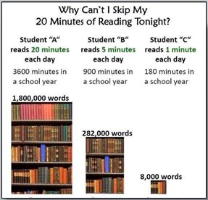

Slide 14


