Slide 1


Introduction to easyfundraising.org.uk

Slide 2

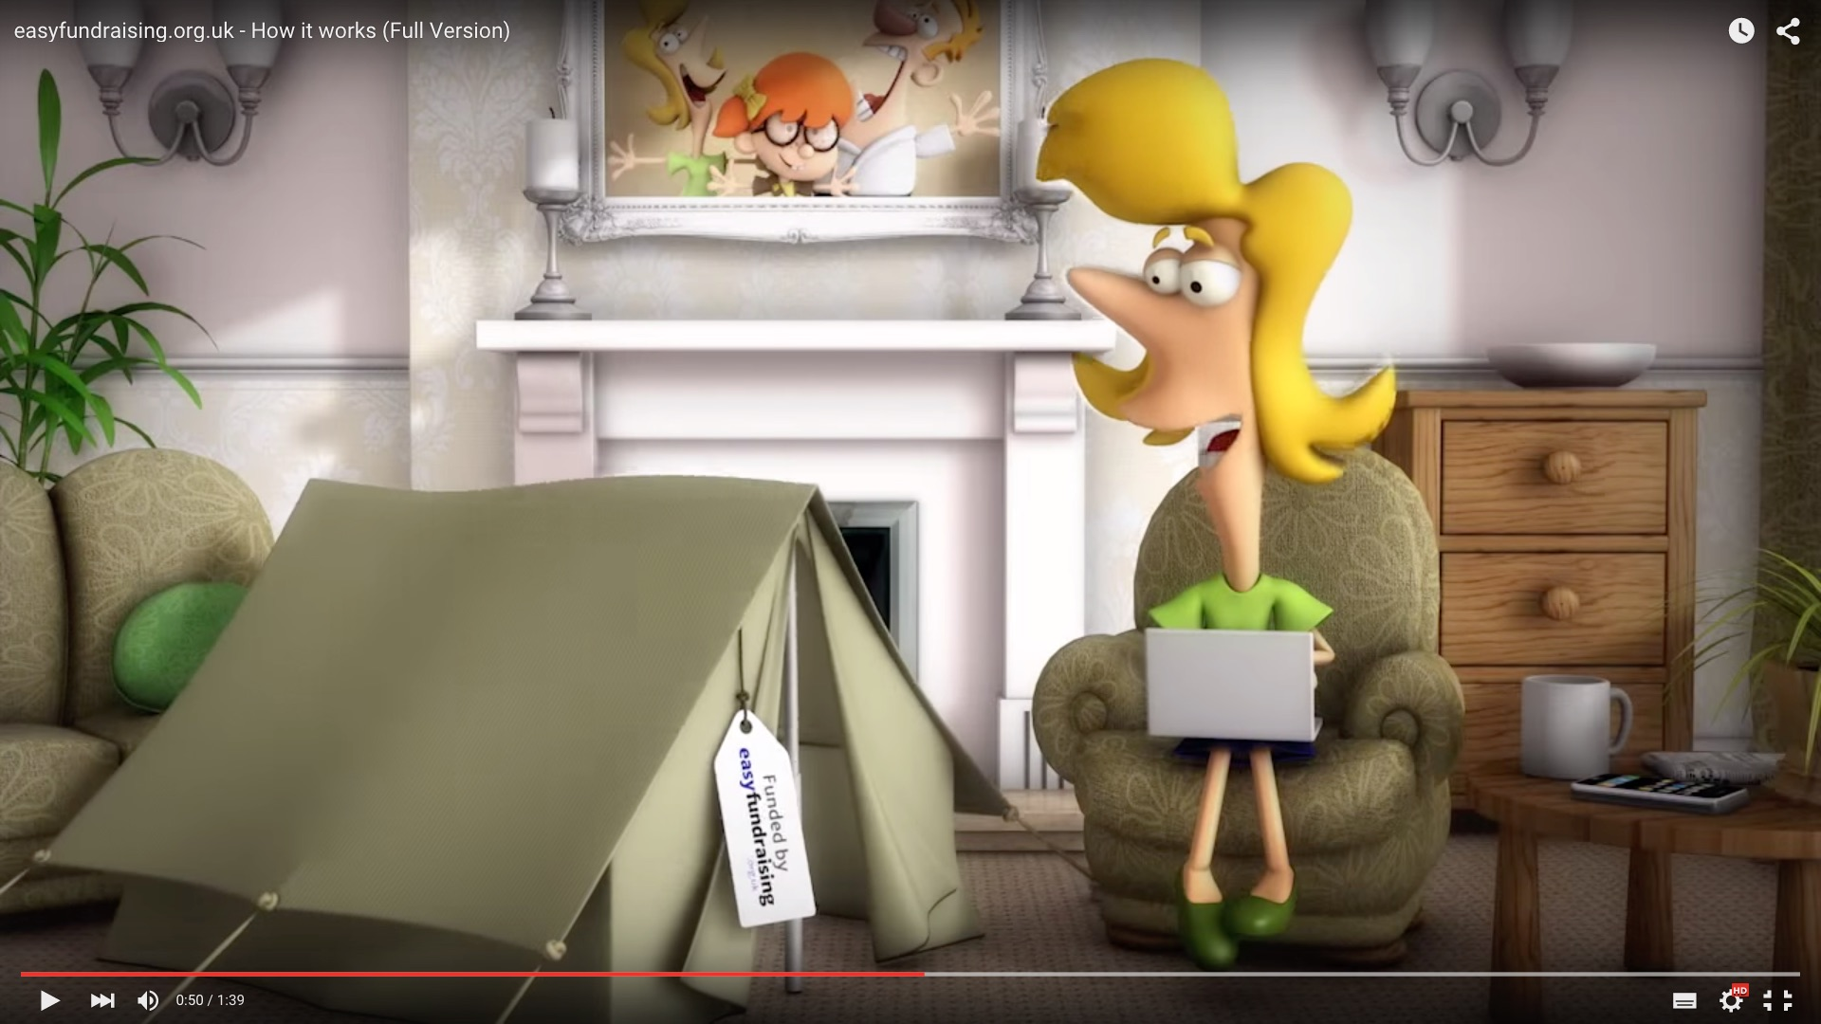


What is easyfundraising?
An easy way to raise school funds for Fern Hill Primary when you shop online – no cost, no catch
There are almost 3,000 retailers on board, so you can raise on everything from uniforms to utility bills
There are already 65,000 charities and good causes signed up
easyfundraising has raised nearly £10m for good causes around the UK
Watch the video »

Slide 3




Here’s how it works
1. Start at easyfundraising.org.uk
Every time you shop online, be it for a hat or a holiday, head to easyfundraising.org.uk first
2. Make a purchase
Search for the retailer you want and shop as normal. Everything’s the same, including the price
3. Get a donation
When you check out, that retailer will make a donation to our school for no extra cost whatsoever!

Slide 4






















Raise on everything
Travel & Days Out
Business Purchases
Fashion & Beauty
School Shopping
Electrical Essentials
Food & Drink

Slide 5

How to get easyfundraising
Go to https://www.easyfundraising.org.uk/causes/fernhillpsa/
Click on Sign up for free & support this cause
Create your account as directed and you’re ready to get fundraising!

Slide 6
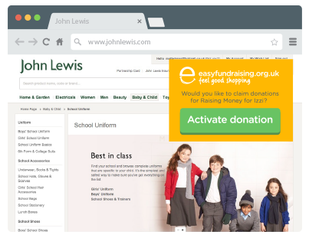
The easyfundraising Donation Reminder
Never miss a free donation with the Donation Reminder. If you think you might forget to shop each time via easyfundraising then the Donation Reminder will help you. It provides a little reminder every time you shop online.
Over 150,000 supporters use it
They raise on average 5x more
It’s free with no annoying ads

Slide 7
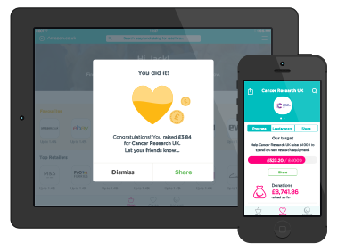
The easyfundraising App
Shop on your mobile or tablet?
Download the free easyfundraising App and make raising donations even easier.
Raise up to 50% more donations
Shop at almost 3,000 retailers on the go
Get notified of your successful donations
Works for iPad, iPhone and iPod touch - coming soon for Android!

Slide 8
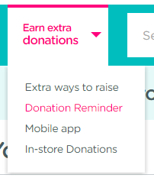
How to download the easyfundraising Donation Reminder or App
Go to easyfundraising.org.uk and register if you don’t already have an account
From your home page, click on ‘Earn extra donations’
Select ‘Donation Reminder’ and/or ‘Mobile app’

Slide 9

5 reasons to sign up now!
It’s an easy, no effort way to raise valuable funds for your school
It doesn’t cost you a penny extra when you shop
You’ll be making a real difference for your children
Join now and you’ll be ready to start raising for Christmas!
It can take just one classroom of parents to raise £190 this Christmas! *
Register your school or sign up to support your school here:
www.easyfundraising.org.uk
* Based on 30 people raising £6.33
each between Oct-Dec

